Slide 1
APU BADMINTON CLUB
Presented by
Group member’s name | TP number
Hen Kian Jun | TP047472
Lee Wai Yen | TP044610
Teh Yi Jia | TP048096

Slide 2

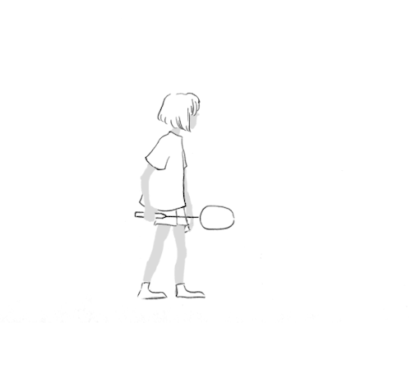
INTRODUCTION
APU Sports club
Badminton
Provide the detailed information for students
Offered to the Asia Pacific University students
Storyboarding and modelling
Evaluation
Discuss about what we faced during developing
Future Enhancement
Providing the suggestion to developing
Conclusion

Slide 3

OBJECTIVES
To design and develop working website
To attract more visitors to visit the club website
To provide sufficient information regards APU badminton club
To provide a user-friendly website

Slide 4
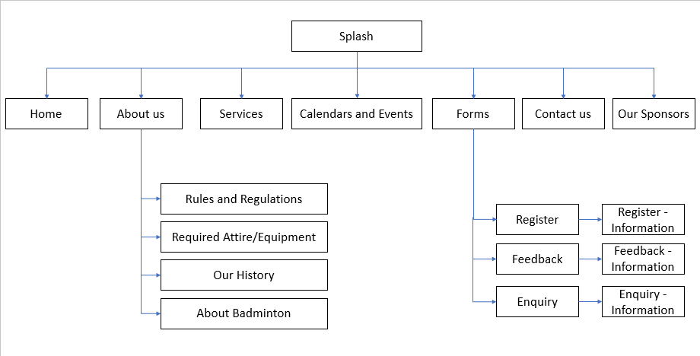
Functional Flow Chart

Slide 5

Screenshot of the working website SPLASH

Slide 6
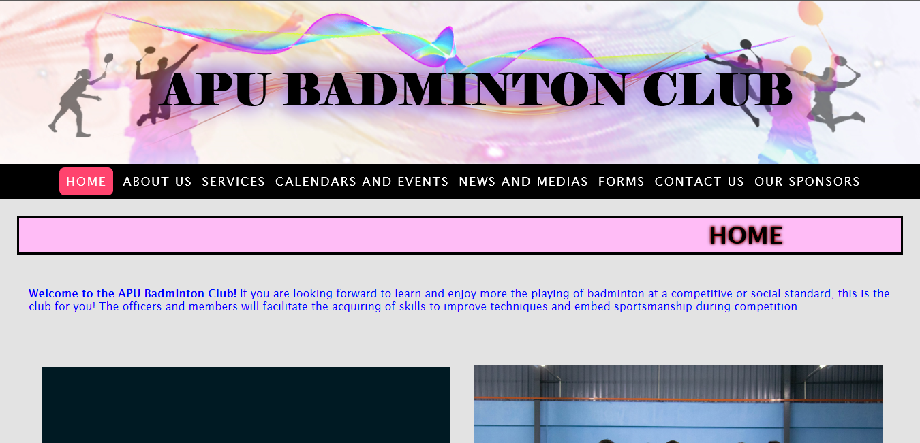
Screenshot of the working website HOME
Down

Slide 7
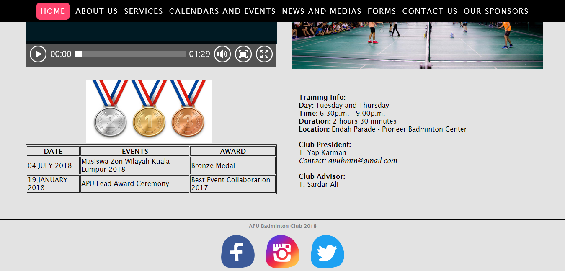

Slide 8
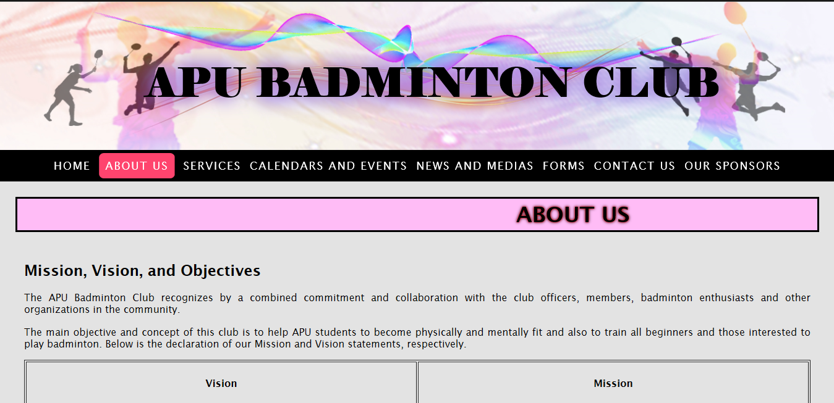
Screenshot of the working website ABOUT US
Down

Slide 9
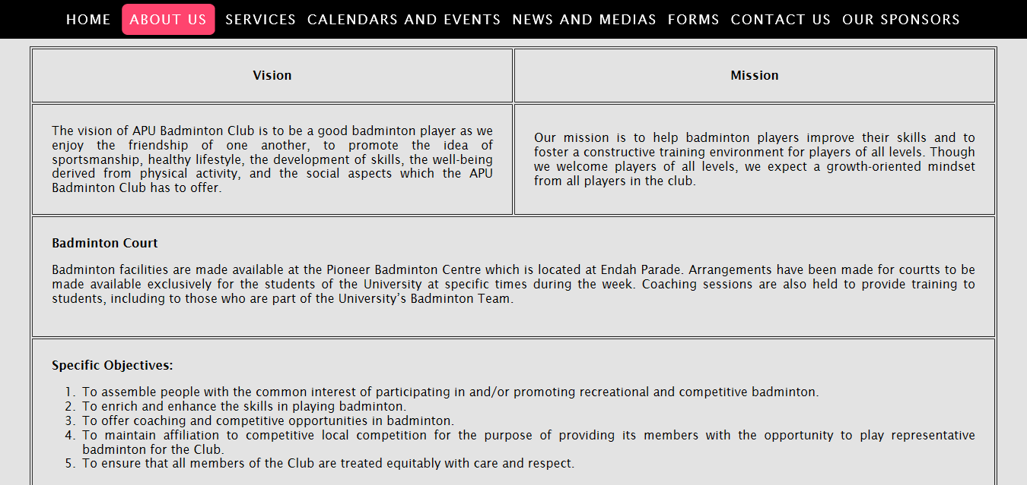
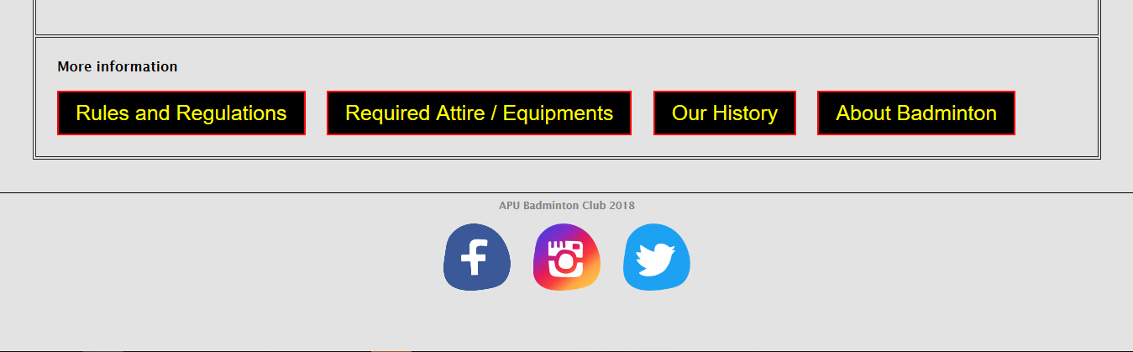
Services

Slide 10
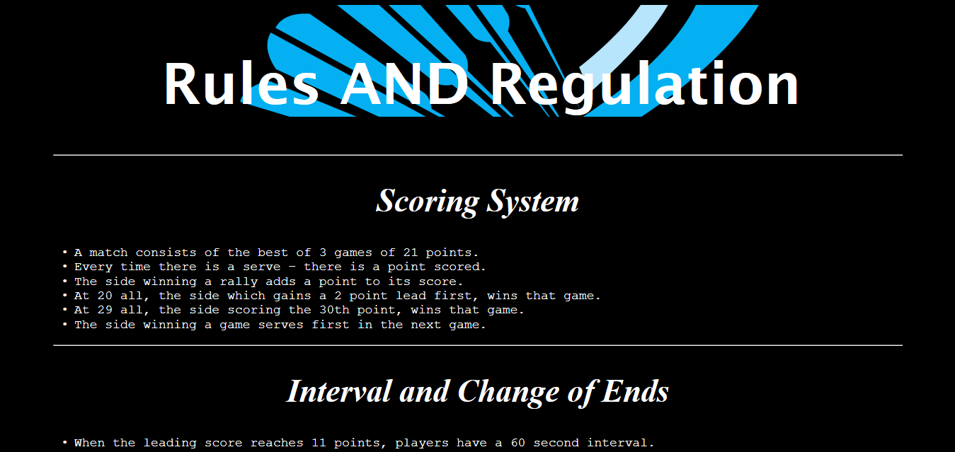
Screenshot of the working website RULES AND REGULATION
Down

Slide 11
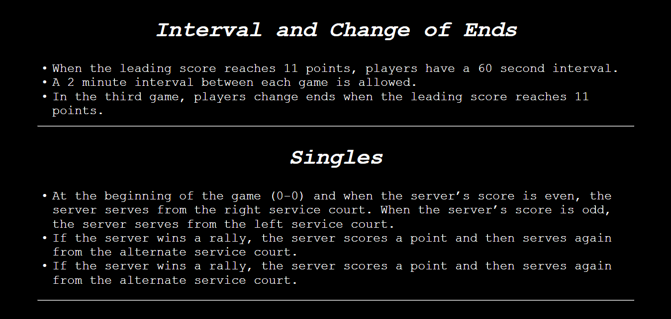
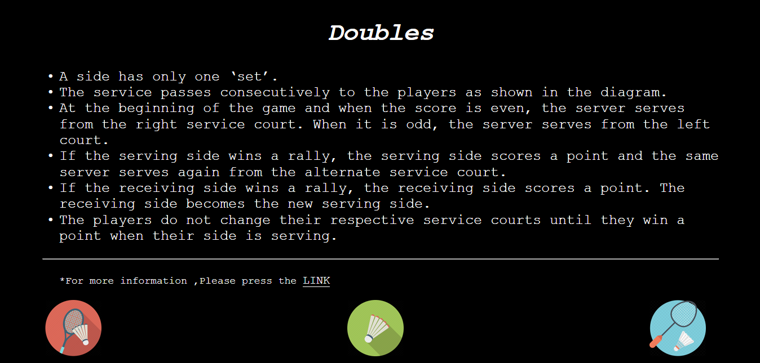
Down

Slide 12
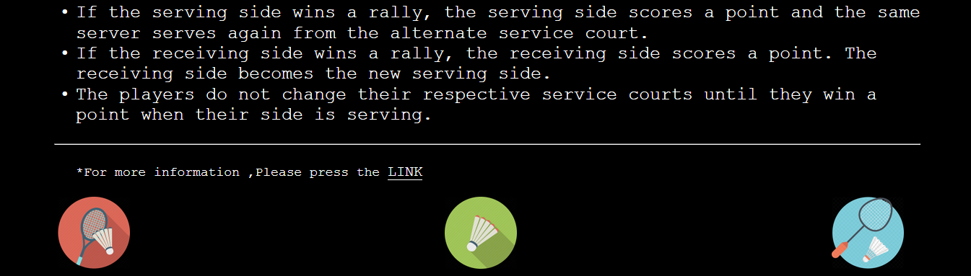

Slide 13

Screenshot of the working website REQUIRED ATTIRE / EQUIPMENT
Down

Slide 14
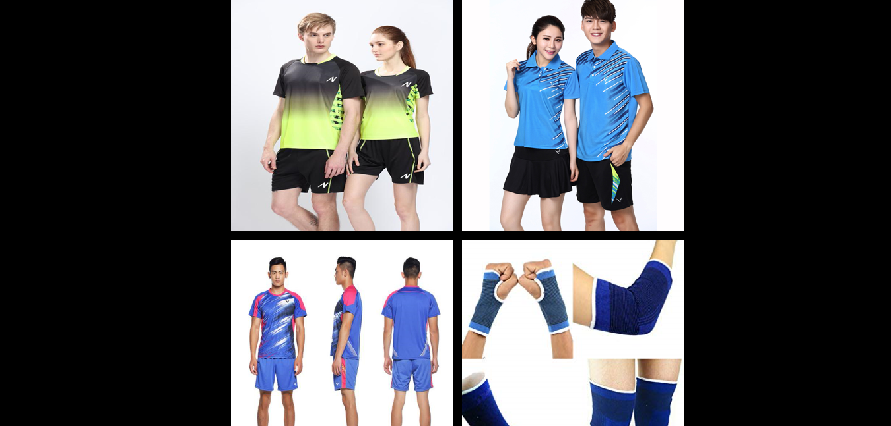
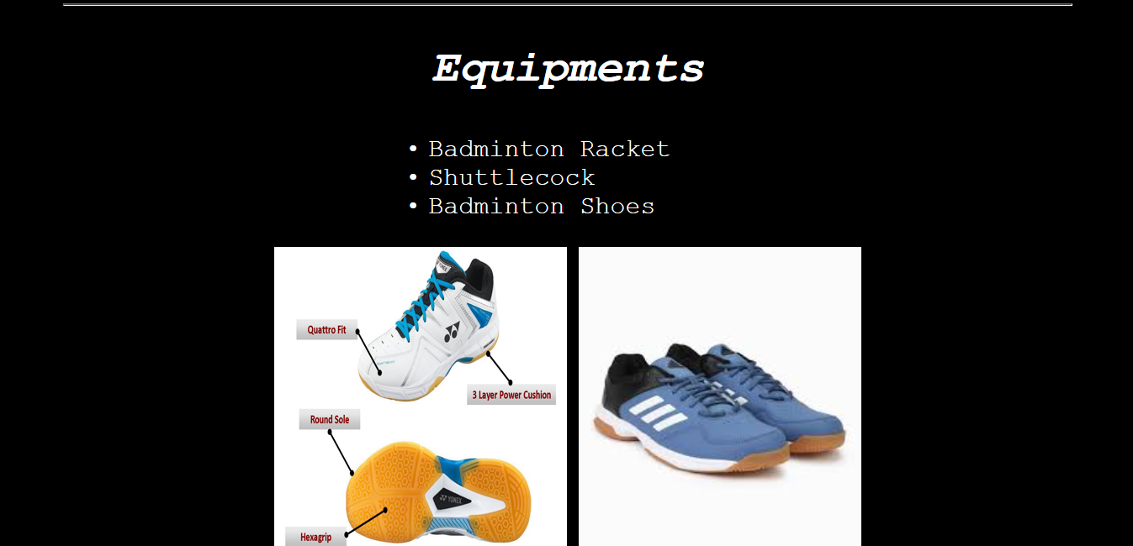
Down

Slide 15
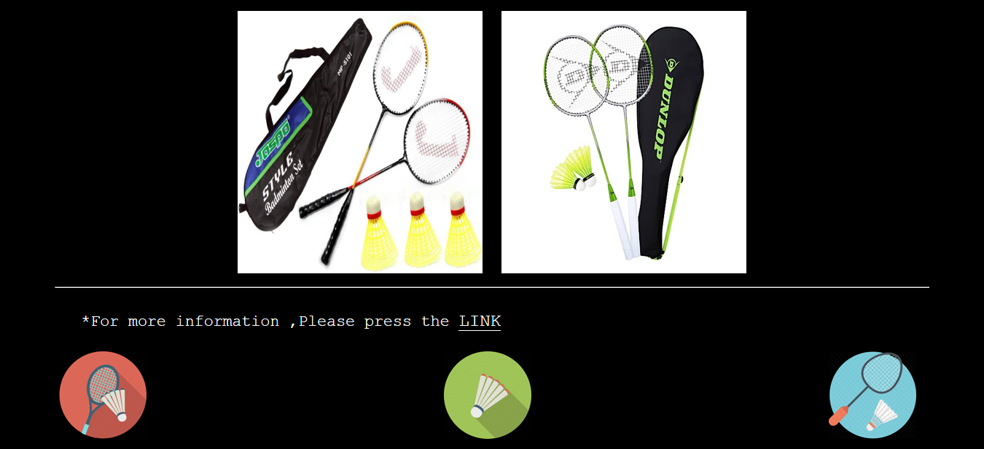

Slide 16

Screenshot of the working website OUR HISTORY
Down

Slide 17
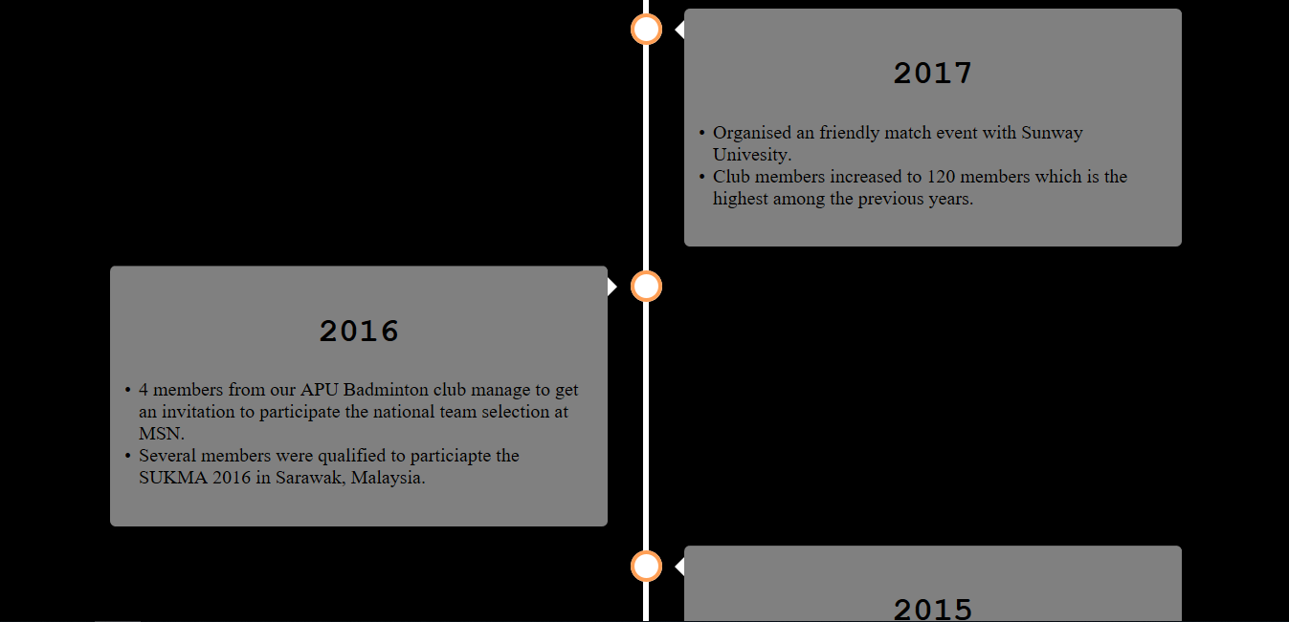


Slide 18
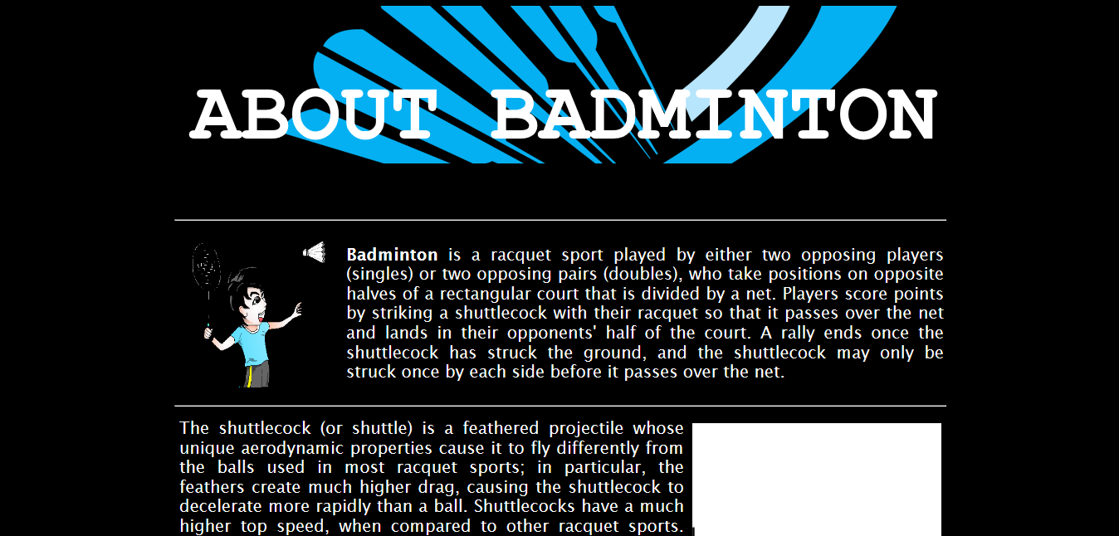
Screenshot of the working website ABOUT BADMINTON
Down

Slide 19
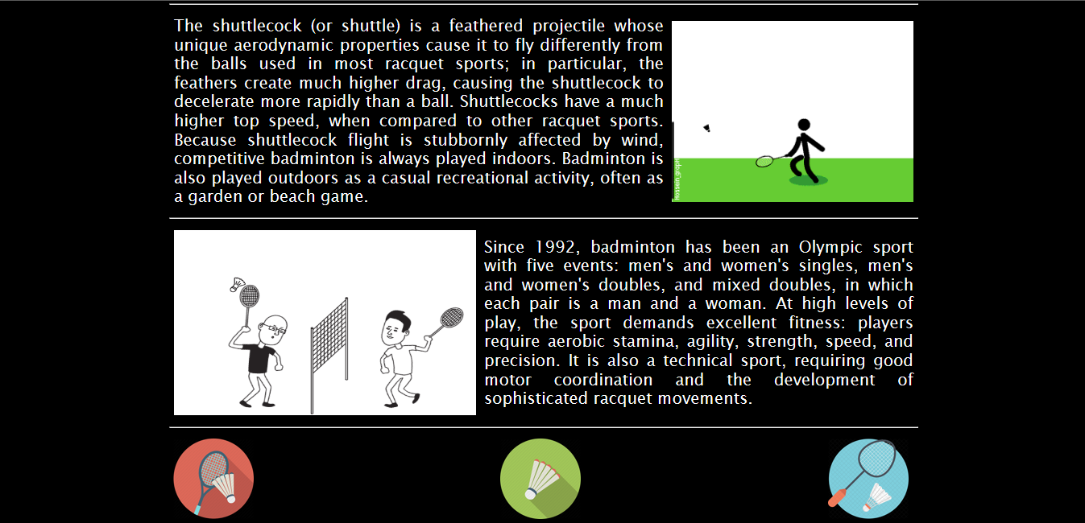

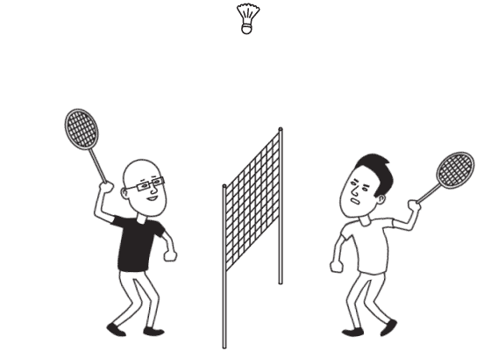

Slide 20
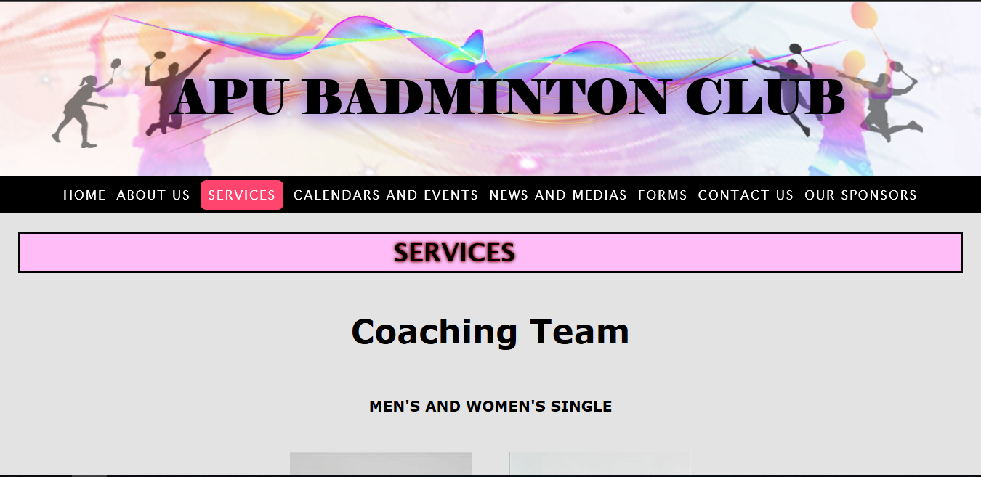
Screenshot of the working website SERVICES
Down

Slide 21
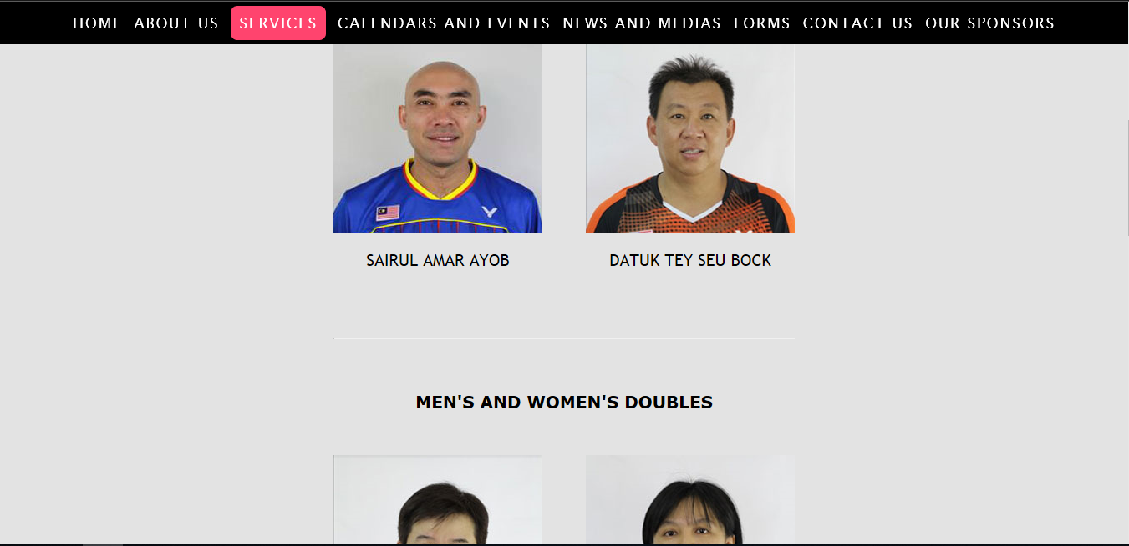
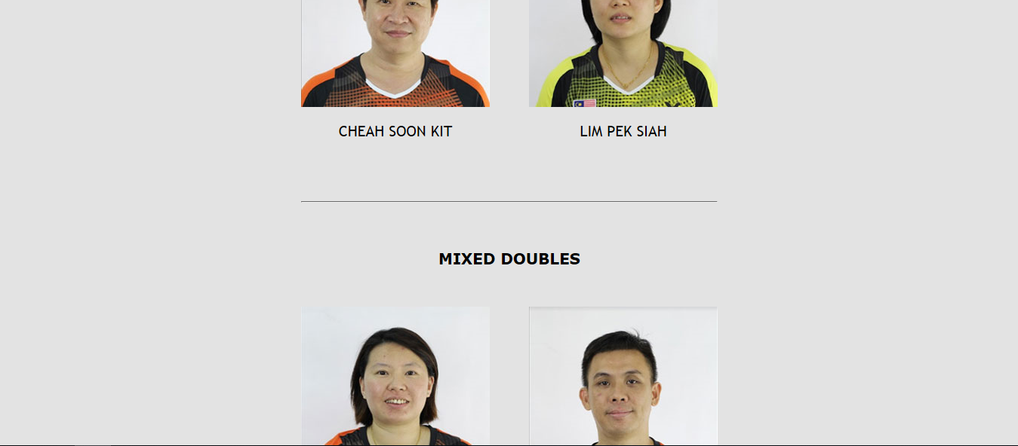
Down

Slide 22
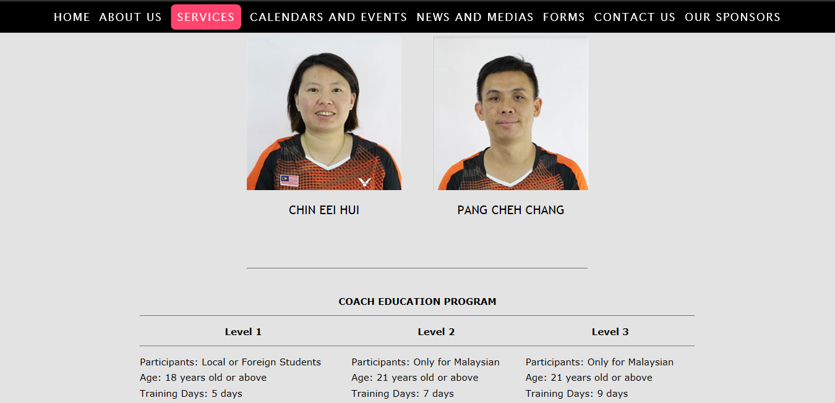
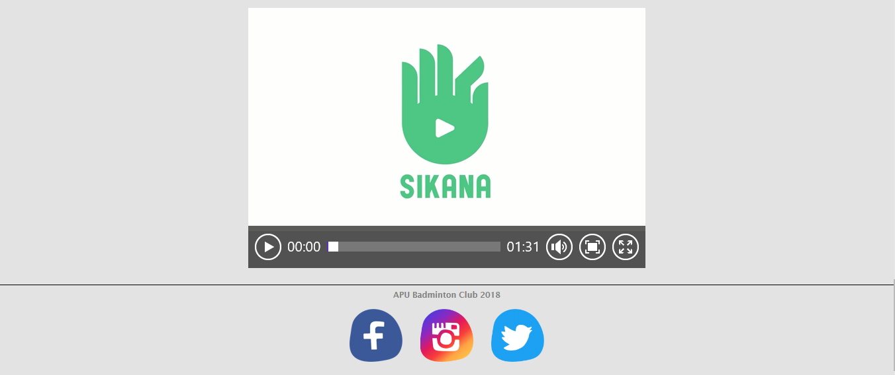

Slide 23
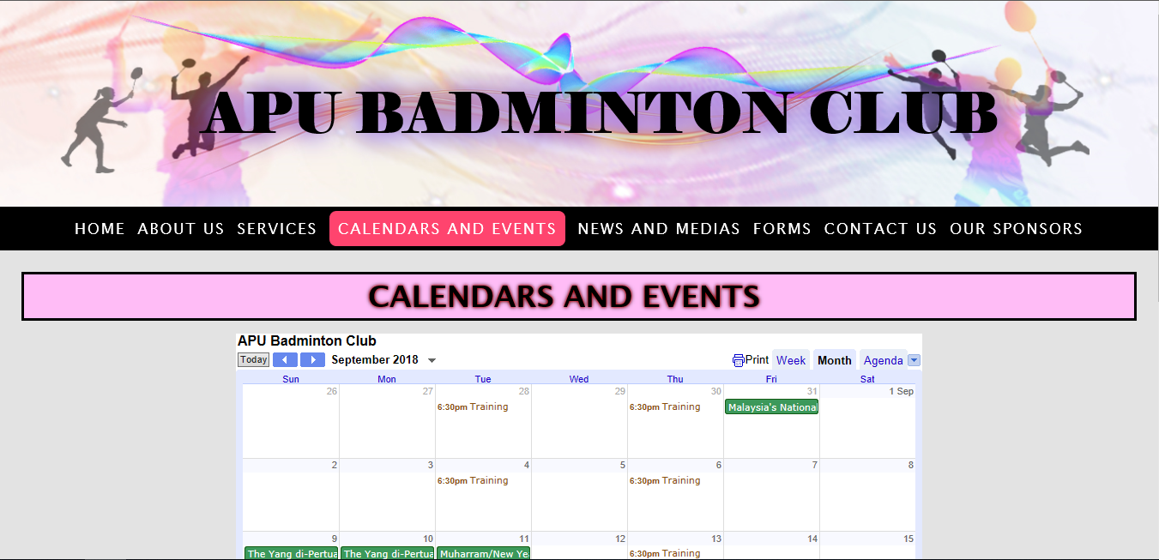
Screenshot of the working website CALENDARS AND EVENTS
Down

Slide 24
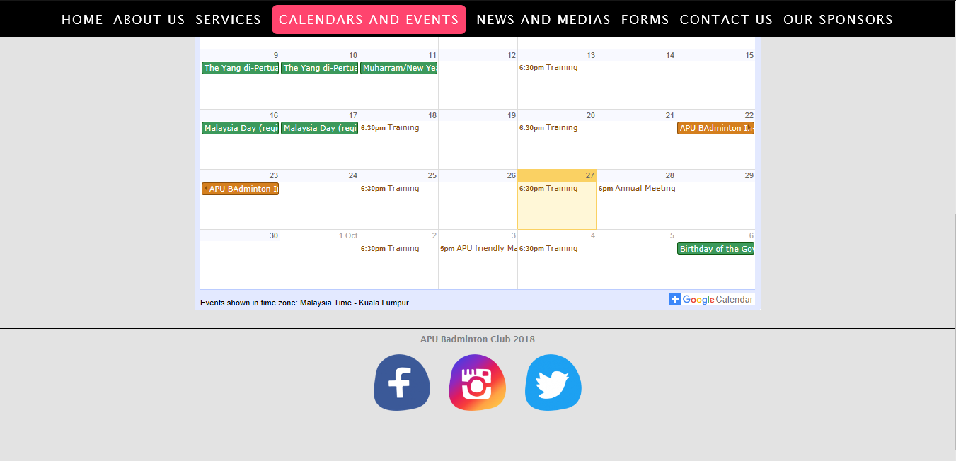

Slide 25
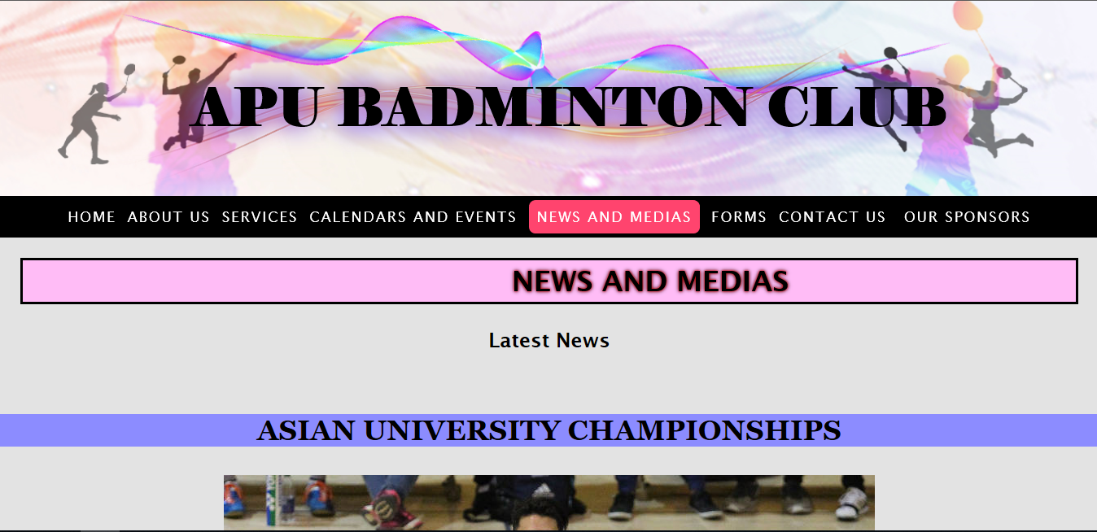
Screenshot of the working website NEWS AND MEDIAS
Down

Slide 26
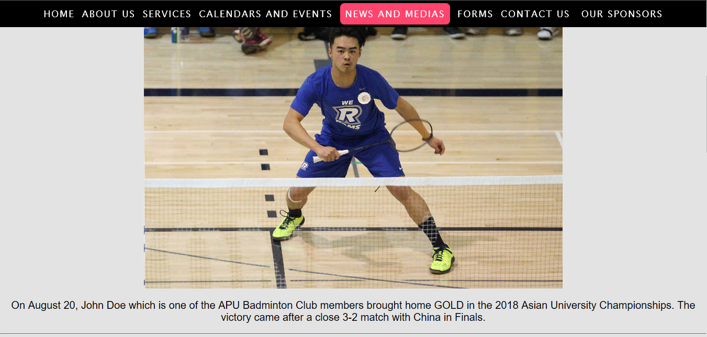
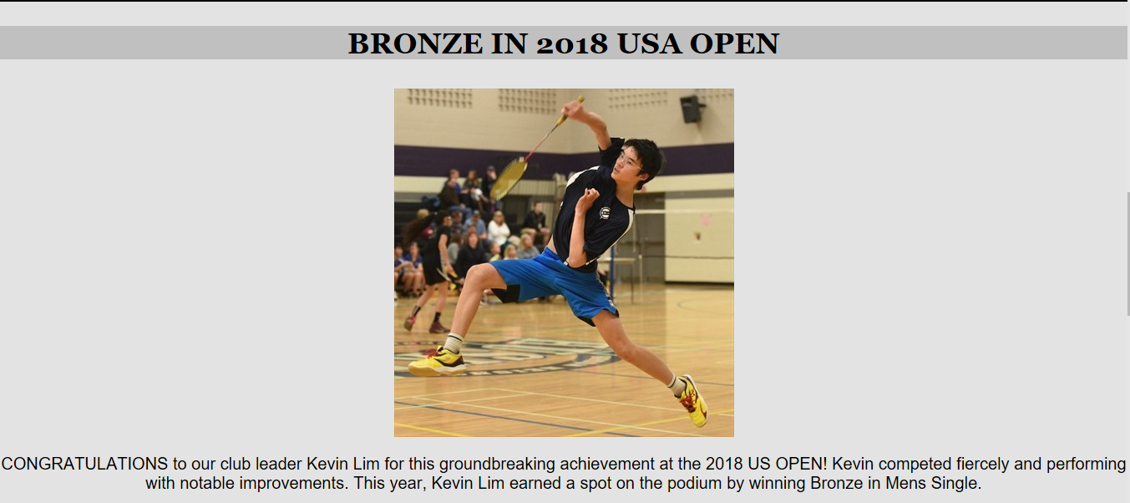
Down

Slide 27
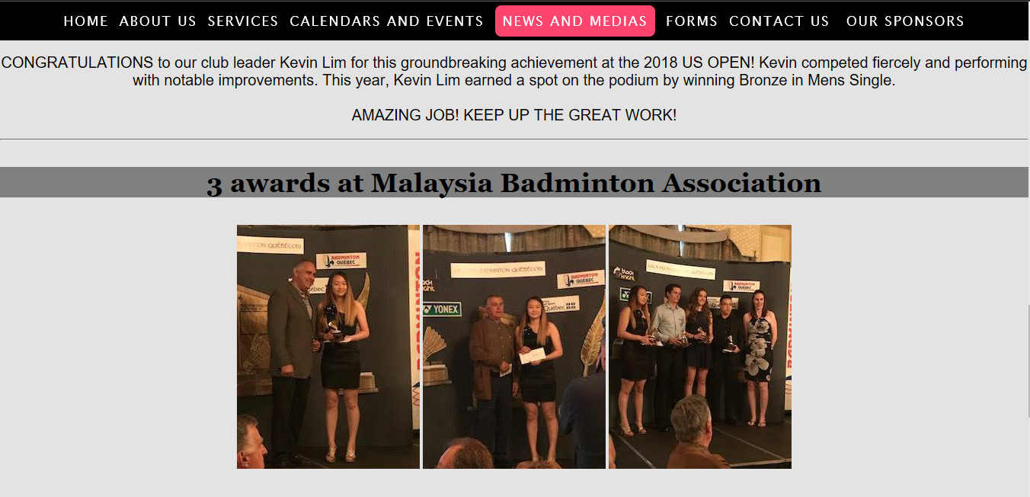
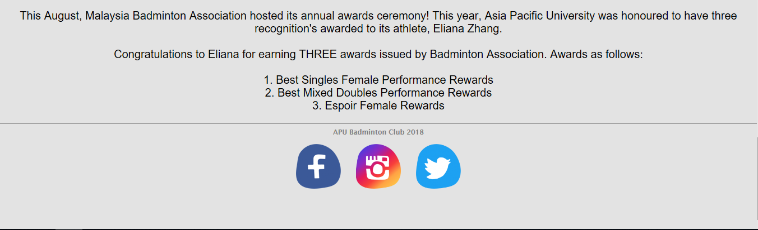

Slide 28
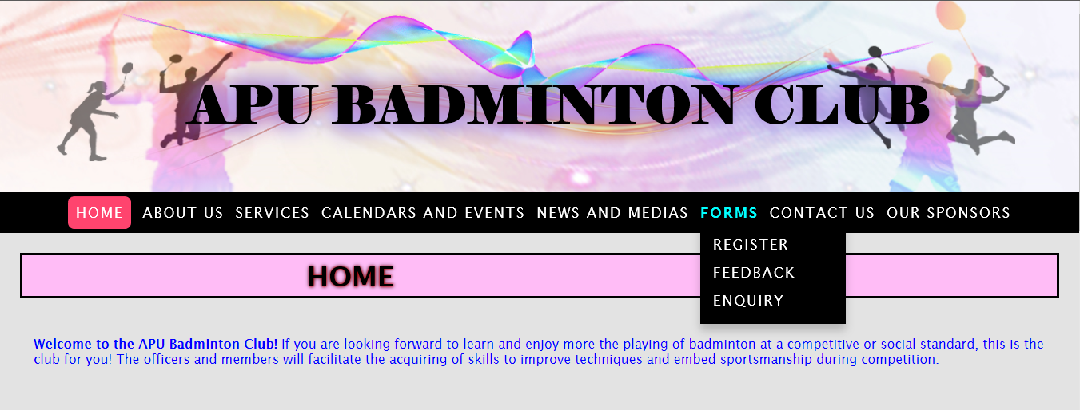
Screenshot of the working website FORMS
Contact

Slide 29
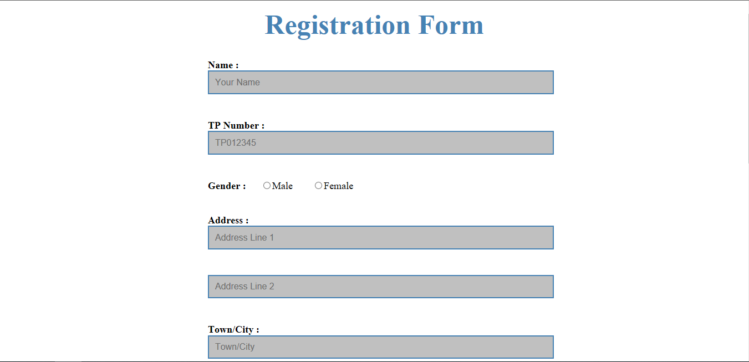
Screenshot of the working website REGISTRATION FORMS
Down

Slide 30
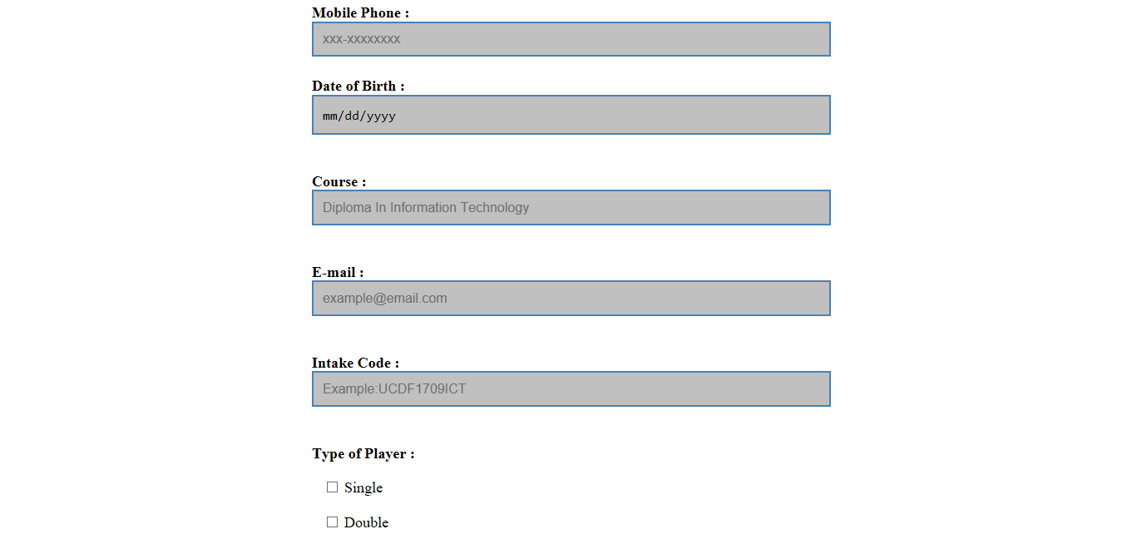


Slide 31
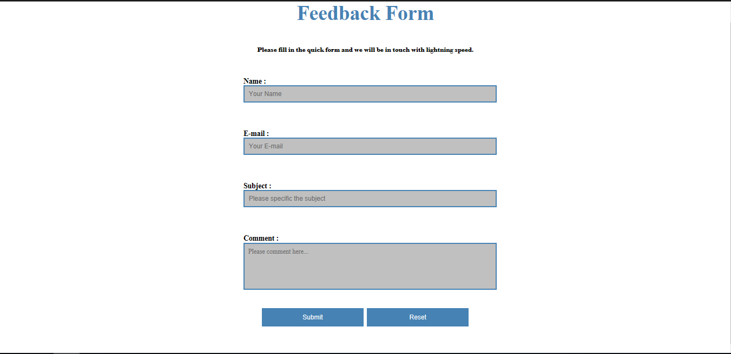
Screenshot of the working website FEEDBACK FORMS

Slide 32
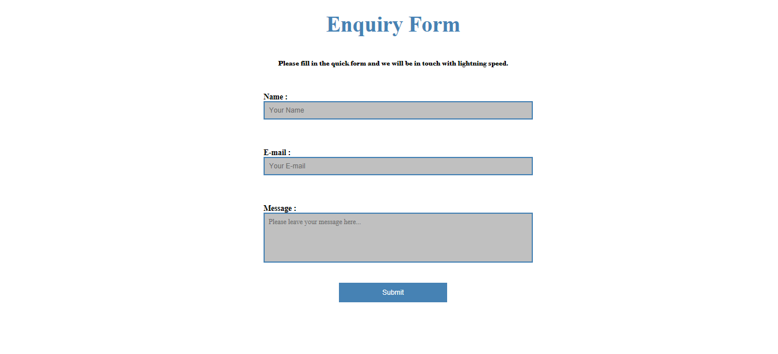
Screenshot of the working website ENQUIRY FORMS

Slide 33
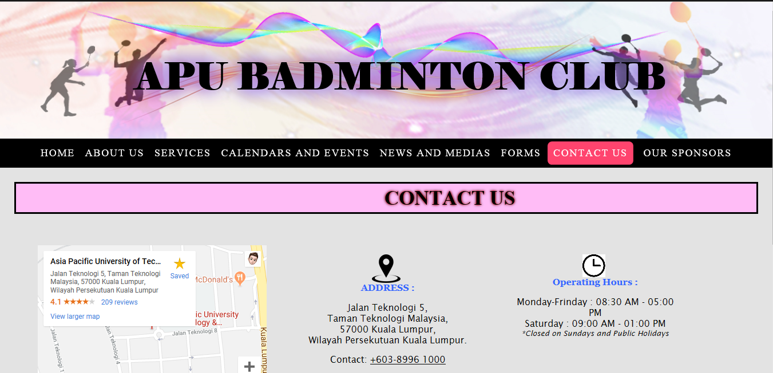
Screenshot of the working website CONTACT US
Down

Slide 34
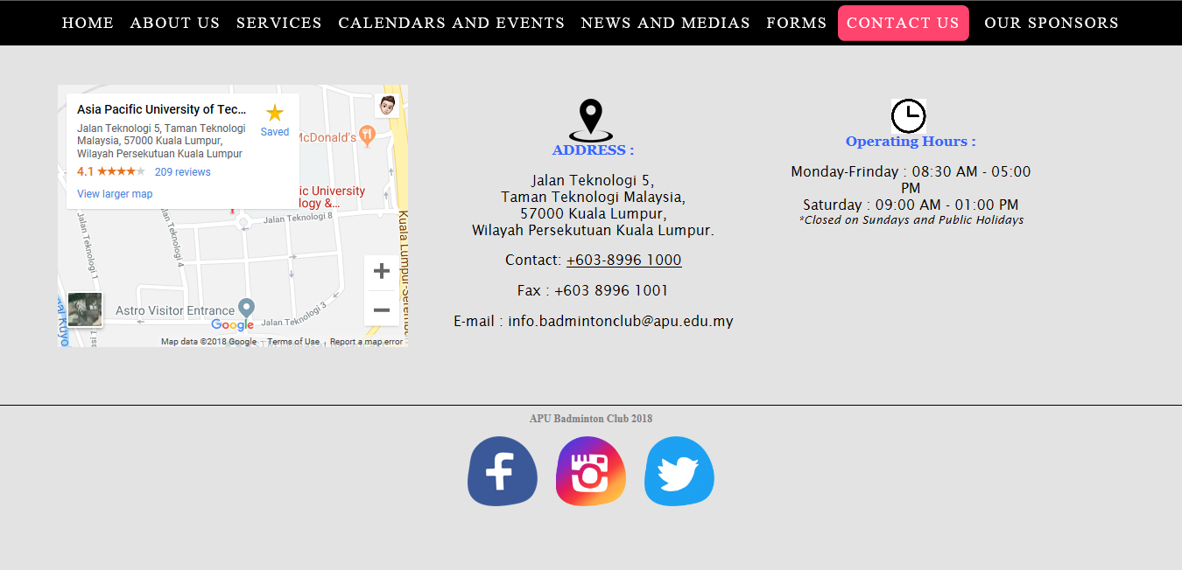

Slide 35

Screenshot of the working website OUR SPONSORS
Down

Slide 36


Slide 37
Evaluation
Challenges
Time spent on creating a well-designed website.
Scope and the requirements of the assignment.
Conflictions among the group members on different ideas.
Difficulties
Restrictions on the programming software.
Improve and discover more programming language from the learning website

Slide 38
Future Enhancement
Manage a feature about Multilanguage options
To allow visitors to change the language such as Melayu
Develop the website into a handheld application
Develop a live stream into this working website
To view the current badminton match
Develop a scanner feature for QR code in this working website as well as the forms (register, enquiry and feedback)
QR code is very convenient for us now

Slide 39
Conclusion
Used Microsoft Web Expression
Combination of HTML, Cascading Style Sheets (CSS) and JavaScript file
Develop a user friendly, attractive and convenient for users
Display more multimedia (videos, icons and photos) to deliver the message

Slide 40

The end ! ☺

